Slide 1
Generating Fuzzy Rules: learning from examples Li-Xin Wang and Jerry M. Mendel
EE685A
MOHD SHAHID AWAN (190504)

Slide 2
Introduction
we are going to generate fuzzy rules from numerical data pairs, collect these fuzzy rules and the linguistic fuzzy rules into a common fuzzy rule base, and finally design a control or signal processing system based on this combined fuzzy rule base.

Slide 3
Generating Fuzzy Rule from Numerical Data
Step 1
Step 2
Step 3
Step 4
Step 5
Assign degree to each generated rule
Create a combined fuzzy rule base based on both the generated rules and linguistic rules of human expert.
Determination of mapping from input space to output space based on the combined fuzzy rule base using a defuzzifying procedure.
Divide input and output space into fuzzy regions
Generate fuzzy rule from given desired input output pairs

Slide 4
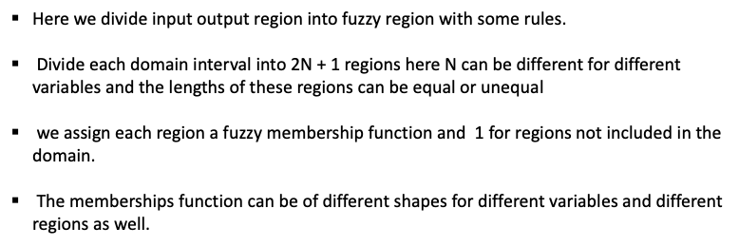
Divide the Data into fuzzy regions

Slide 5
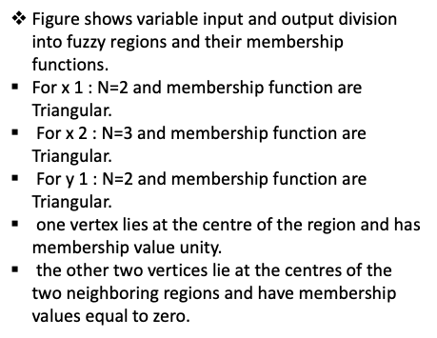
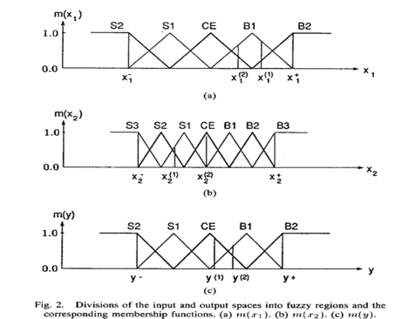

Slide 6
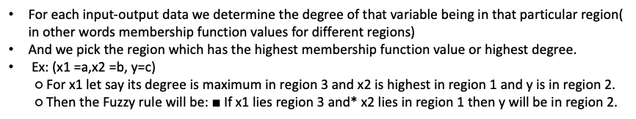
Fuzzy rules generation from data

Slide 7
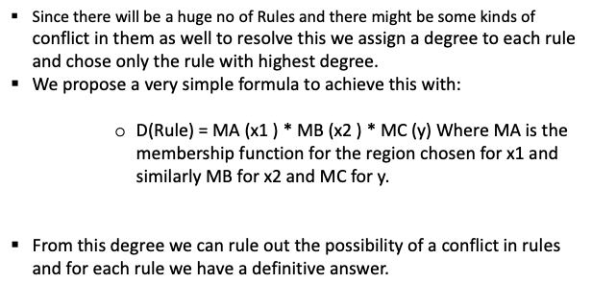
Degree to each rule

Slide 8
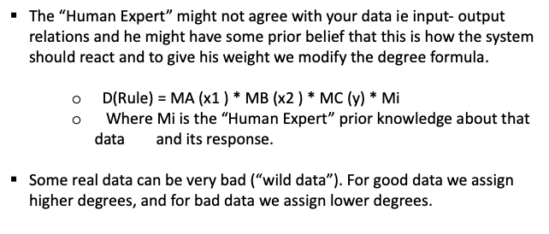

Slide 9
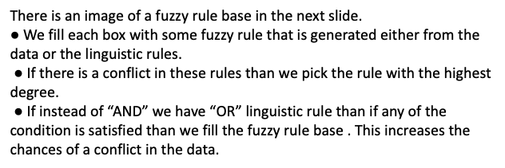
Combined fuzzy rule base

Slide 10
Application to Truck Backer Upper Control
The truck position is exactly determined by the three state variables, two input variable and one output variable
Whose inputs are ϕ E [-90°,2700] and x E [0,20], and whose output is θ E [-4O°,4O°], such that the final states will be (Xf,ϕf) = (10,9O°).
For finding out the next position of truck, following equations of dynamic state representation of truck are used and this is approximated kinematics:
𝑥(𝑡 + 1) = 𝑥(𝑡) + cos[∅(𝑡) + 𝜃(𝑡)] + 𝑠𝑖𝑛[ 𝜃(𝑡)]𝑠𝑖𝑛[∅(𝑡)]
𝑦(𝑡 + 1) = 𝑦(𝑡) + sin[∅(𝑡) + 𝜃(𝑡)] − 𝑠𝑖𝑛[ 𝜃(𝑡)]𝑐𝑜𝑠[∅(𝑡)]
∅(𝑡 + 1) = ∅(𝑡) − sin−1 [ 2sin{𝜃(𝑡)}/b]

Slide 11
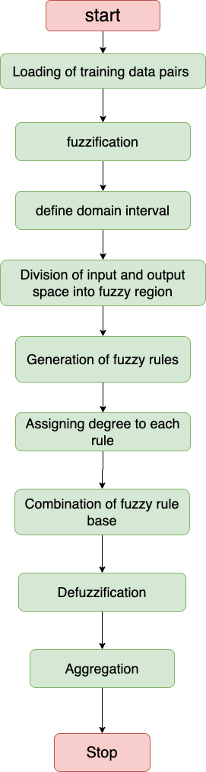
Flow chart for Truck Backer Upper Control :

Slide 12
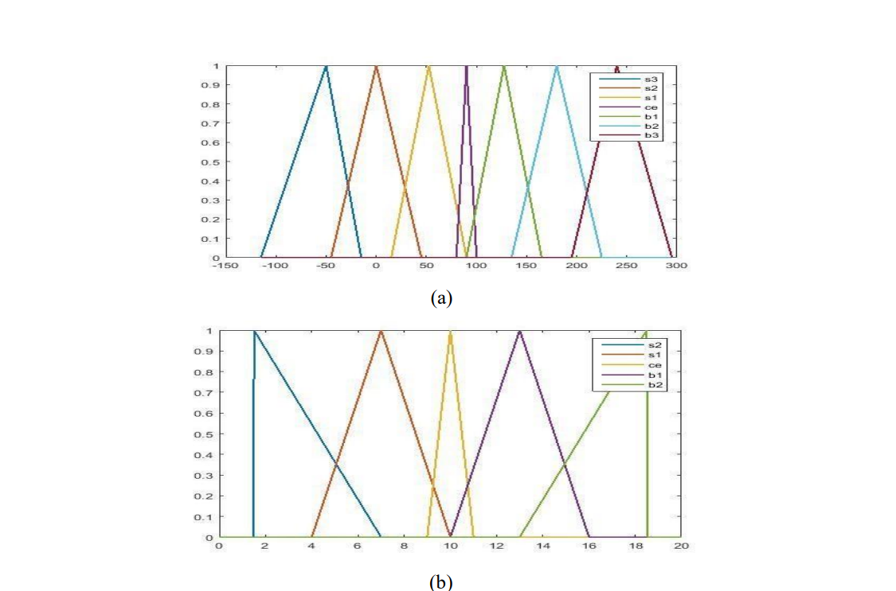
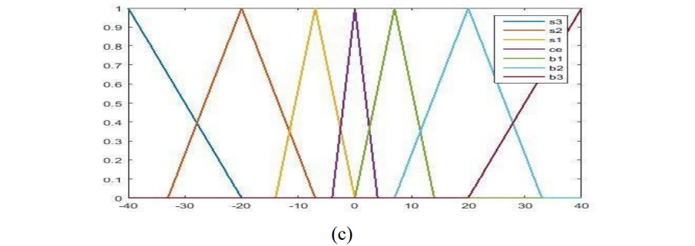
We are going to divide our inputs into fuzzy regions. The regions used are shown in below figure.

Slide 13
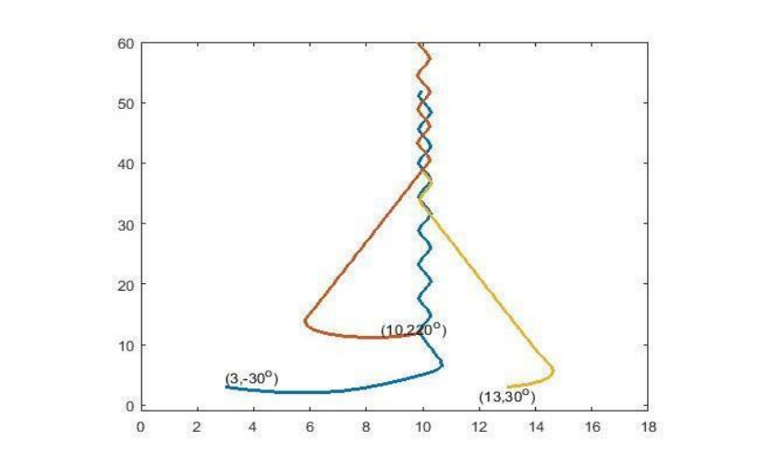
Truck Trajectory using Numerical Data only

Slide 14
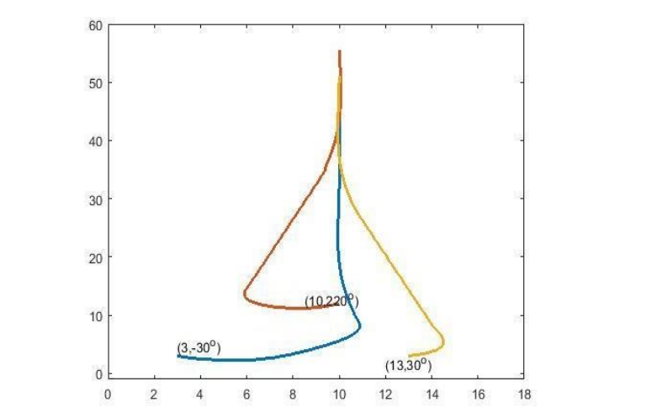
Truck Trajectory using both Numerical Data and Linguistic Information

Slide 15
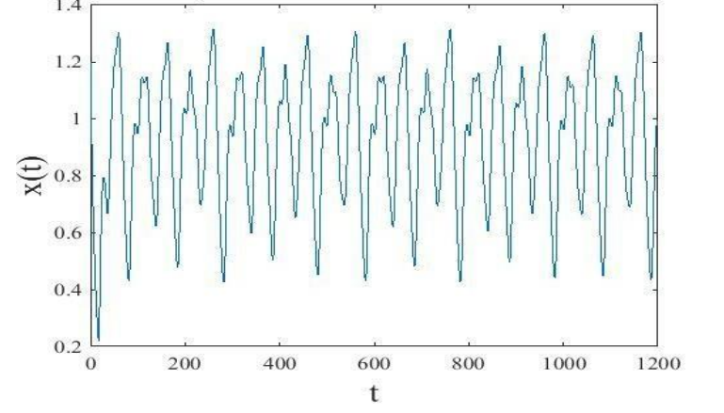
Application to Time Series prediction when Tau=17

Slide 16

Acknowledgement

Slide 17
Thanks

